Slide 1



Laboratory Information Management System
CMIS3242-PROJECT PRESENTATION
INDEX NO:162006

Slide 2

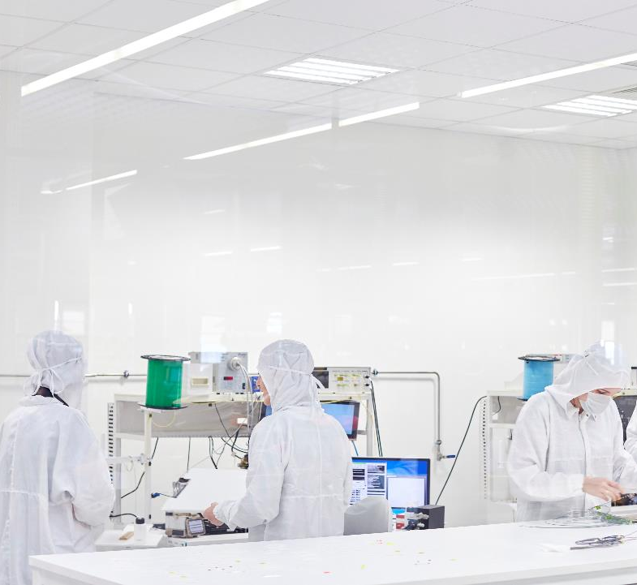
Introduction
LIMS Build for a Laboratory.
Manage the patient test sample information and the details about medical tests.
Used context awareness for a better convenience of use.

Slide 3

Proposed System
Patient gets registered by the receptionist with RFID tag.
When the patient goes near to the relevant machine or device, the RFID detector detects the tag and identify the patient.

Slide 4


Methodology
Every patient assigned to a specific RFID tag
RFID detector check is it a patient RFID tag or not when the RFID tag is near
After the test results have been entered, the system check for the next patient.

Slide 5


Tools
HTML
CSS
PHP
Arduino

Slide 6
Demonstration

Slide 7
Thank you!

